Slide 1

Varendra University
Dept. of Computer Science & Engineering (CSE)
Lab 6
Course Title: Microprocessor and Assembly Language Lab
Course No: CSE 3206
Prepared By:
Md. Adnan Sami
Lecturer, Dept. of CSE, VU

Slide 2
Experiment No: 06
Name of the Experiment:
    Write an assembly language program where input is given by user, if input is y or Y then print it *VU_CSE* otherwise terminate the program using EMU8086.
    Implement a program in EMU8086 that uses shift or bitwise operations to check if a number is even or odd.

Slide 3
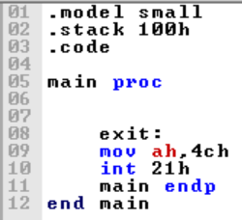
  Return

Slide 4
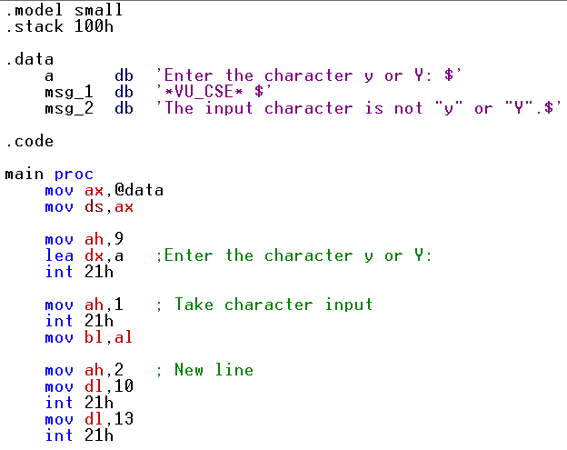
  1. Write some code in assembly language where input is given by user, if input is y or Y then print it *VU_CSE* otherwise terminate the program using EMU8086.
Notes:
s

Slide 5
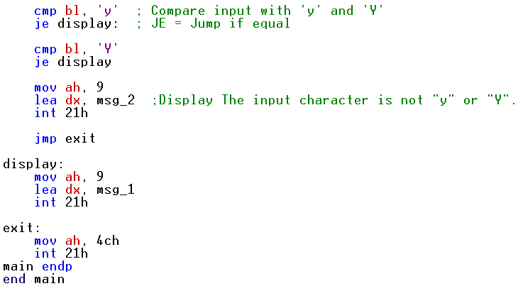
  2. Write some code in assembly language where input is given by user, if input is y or Y then print it *VU_CSE* otherwise terminate the program using EMU8086.
Notes:
s

